Slide 1
Optimizing Video Game Sales
By Daniel Jin

Slide 2
Introduction
When creating a new game, developers need to keep potential sales in mind. What attributes should be selected to optimize game sales? Should the game be on the Wii or the PC? Should it be an Action game or Puzzle game? This analysis aims to answer this.

Slide 3
Dataset
Located on Kaggle at https://www.kaggle.com/rush4ratio/video-game-sales-with-ratings
Combines web scrape of VGChartz data with a web scrape from Metacritic in Dec 2016
Metacritic only includes a subset of the platforms available on VGChartz so there are null values in some columns

Slide 4
Dataset
Name – Title of the game
Platform – What platform the game is on
Year_of_Release – The year the game was released
Genre – Genre of the game (one)
Publisher – Publisher of the game
NA_Sales – Sales in North America (in millions)
EU_Sales – Sales in Europe (in millions)
JP_Sales – Sales in Japan (in millions)
Other_Sales – Sales in the rest of the world (in millions)
Global_Sales – Total worldwide sales (in millions)
Critic_Score – Aggregate score compiled by Metacritic staff
Critic_Count – Number of critics used in Critic_Score
User_Score – Score by Metacritic’s subscribers
User_Count – Number of users in the User_Score
Developer – Party responsible for developing the game
Rating – The ESRB Ratings

Slide 5
Data Cleaning
Removed all null values
Converted variables into the proper data type
For the Platform variable, Dreamcast and WiiU were combined into ‘Other’
For the Publisher variable, any publisher with 29 or less observations were combined into ‘Other’
For the Developer variable, any developers outside the range of the top 50 developers were combined into ‘Other’
A new variable was created to indicate if Publisher was the same as the Developer
Year_of_Release was changed to Years_Since_Release. A game released in 2016 was assumed to be 1 year
Changed the Rating of games tagged AO to M, K-A to E, and RP to T (most populated)

Slide 6
Exploratory Data Analysis
16719 observations in the original dataset
6825 observations in the cleaned dataset
Wii Sports is the leader in Global_Sales at 82.53 million

Slide 7
Exploratory Data Analysis
Three visualizations for each categorical variable
Categories versus Global Sales
Counts of categories
Average sales per title for each category

Slide 8
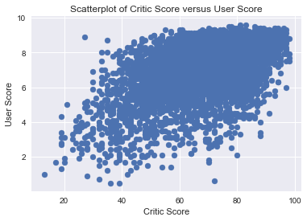
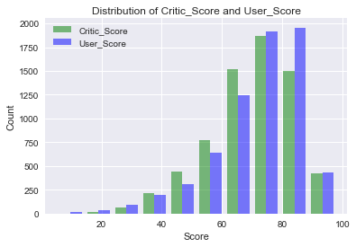
Exploratory Data Analysis
User_Score and Critic_Score have a moderate-strong positive correlation of 0.58. All other variables have little to weak correlations.
Collinearity may be a problem

Slide 9
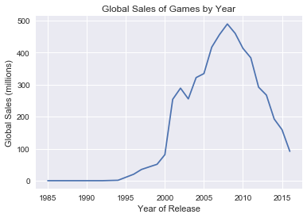
Exploratory Data Analysis
Years since release and Global sales does not have a linear relationship.
Full details of the EDA findings are located in the project report

Slide 10
Data Preparation
The cleaned data was split into 80% train and 20% test. Both the statistical models and machine learning models are built using the same training data.
Categorical variables were converted to dummy variables when necessary. The most populated group was used as the reference group.

Slide 11
Building a Statistical Model
The initial features were selected by modeling Global_Sales through each of the features through simple linear regression. Results are summarized below.
Variable | P-value | Significant?
Platform | ~0 | Yes
Genre | ~0 | Yes
Publisher | ~0 | Yes
Critic_Score | ~0 | Yes
Critic_Count | ~0 | Yes
User_Score | ~0 | Yes
User_Count | ~0 | Yes
Developer | ~0 | Yes
Rating | ~0 | Yes
Dev_same_publisher | 0.245 | No
Years_Since_Release | 0.702 | No

Slide 12
Data Preparation
Added a D_ and P_ prefix to the Developer and Publisher categories respectively to avoid overlap.

Slide 13
Building a Statistical Model
A multiple linear regression model was formed using all the significant variables at the univariate level. I checked to see if the model could be reduced using a partial F test. Results are summarized below.
Variable to remove | Conclusion
Platform | Full model
Genre | Full model
Publisher | Full model
Critic_Score | Full model
Critic_Count | Full model
User_Score | Full model
User_Count | Full model
Developer | Full model
Rating | Full model

Slide 14
Building a Statistical Model
Variable to add | Conclusion
Dev_same_publisher | Reduced model
Years_Since_Release | Full model

Slide 15
Building a Statistical Model
The highest variance inflation factor was 58.5, belonging to Critic_Score. Second highest was 47.1 (User_Score). User_Score unexpectedly had a negative coefficient so collinearity is clearly an issue
I removed Critic_Score from the model. The VIF for User_Score remains high at 23.7, but the coefficient is now positive
No other variables were highly correlated between continuous variables so no other variables were removed

Slide 16
Building a Statistical Model
I checked a few interactions that made sense. I used the p value of the term for single interaction terms. Results are summarized below.
Interaction | Conclusion
User_Score * User_Count | Reduced Model
Critic_Count * Years_Since_Release | Full model
User_Count * Years_Since_Release | Reduced model
Critic_Count * Rating | Full model

Slide 17
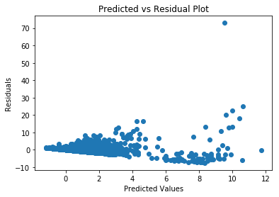
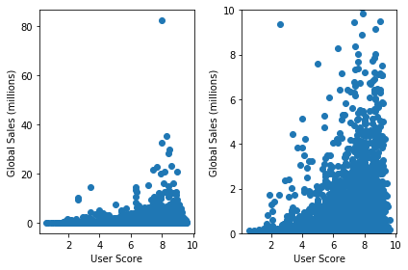
Building a Statistical Model
Above we see the homoscedasticity assumption violated.
User_Score and Global_Sales does not have a linear relationship
Critic_Count and User_Count appear to have a linear relationship with Global_Sales

Slide 18
Building a Statistical Model
Adding a User_Score² term did not help
Various methods including box-cox and weighted regression were tried to fix the non-constant variance. None worked.
A natural log transformation of Global_Sales was the best option
Three different models were chosen trading between better residuals and better fit for comparison purposes

Slide 19
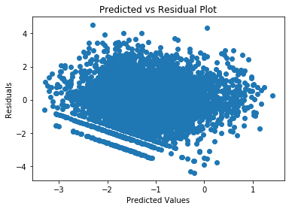
Building a Statistical Model
Model 2 was the best statistical model
ln(Global_Sales) = β₀ + Critic_Count + User_Score + Genre + Rating + User_Score²

Slide 20
Building a Statistical Model
Model 1 included all of the terms after the interaction terms were added.
Model 3 only had Platform, Genre, and Rating in the model
Below are the results of the prediction on the test set using Mean Squared Error as the accuracy metric
Model | Mean Squared Error | Root Mean Squared Error
1 | 2.830 | 1.68
2 | 2.609 | 1.62
3 | 2.828 | 1.68

Slide 21
Building a Machine Learning Model
The features found significant in the univariate analysis part of the statistical model were used
Check the Capstone project 1 part 2 notebook to see the hyper parameter space chosen

Slide 22
Building a Machine Learning Model
Model | Mean Squared Error (non-log) | Mean Squared Error (log)
Linear Regression | 2.005 | 2.208
Ridge Regression | 2.010 | 2.215
Support Vector Regression | 1.919 | 1.758
Random Forest Regression | 1.479 | 1.825
Extreme Gradient Boosting Regression | 1.517 | 5.914
The Random Forest model performed the best with the lowest MSE
All except the log XGBoost performed better than statistical model
Check the project report for details regarding each model’s performance

Slide 23
Limitations
Any trends and conclusions only applies to video games from Metacritic
The Genre variable is not well-defined since it can only contain one value when games are consisted of multiple
The “Other” category for Developer, Publisher, and Platform do not represent all other categories not listed. It depends on how they were defined
Some categories have a low sample size and have bias associated with them
Data may not be accurate
Results may have occurred by chance due to how the data were split into the training and test groups

Slide 24
Conclusion
According to the statistical analysis, if you want to optimize game sales, you should create a game in the ‘Misc’ genre and rated ‘E’.
It’s also important to study games with a high Critic_Count and high User_Score to find out what details about the game the user enjoys that can’t be captured in a dataset
Though, keep in mind that there were some violated assumptions so this is not completely conclusive

Slide 25
Conclusion
Overall, the machine learning models had higher predictive power compared to the “best” statistical model using MSE as the metric.
Can use the Random Forest regression model to use for future test cases, i.e. a proposed game to see how well it would do compared to another proposed game

Slide 26
Future Work
For a future analysis, could try using a non-linear model or generalized linear model instead of a linear regression model
Web scrape up to date data for VGChartz and Metacritic
Find better data with multiple genre tags or other variables of interest for additional analysis

